Slide 1

Key Consistent Tune Generation using Sequence Modelling
Created by:
Student Id: 1223507
Name: Ananya Shankar Chittoor
Notes:
Good afternoon, everyone.
My name is Ananya Shankar Chittoor, and today I will be presenting my project on 'Key Consistent Tune Generation using Sequence Modelling.'
This project explores how sequence modelling, a form of deep learning, can be applied to generate melodies that maintain a consistent key throughout.
The goal was to create a model capable of generating melodies that are not only musically coherent but also key-consistent, which is a significant challenge in computational music generation. So, let's dive into the details and see how sequence modelling can be harnessed to create music!

Slide 2
WHY WE CHOSE RNN?
Sequential Data Processing
Ability to Capture Temporal Dependencies
Learning from Past Data
Versatility with Variants (LSTM, GRU)
Proven Success in Music Generation
Notes:
Music is a sequence of notes, and RNNs are specifically designed to handle sequential data, making them an ideal choice for music generation.
Remember if you forget temporal = dependency between past and future i.e past has effect on future data
RNNs utilize their internal state (memory) to process sequences, allowing them to learn from previous notes and predict future notes effectively.
RNNs, especially their variants like LSTM and GRU, are capable of handling long-term dependencies, overcoming issues like the vanishing gradient problem seen in traditional RNNs.
RNN-based models have been successfully used in previous music generation tasks, providing a strong foundation for further exploration and innovation.

Slide 3
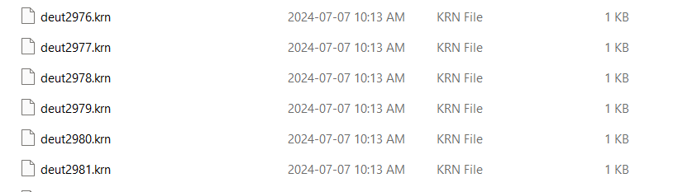
DATASET STRUCTURE
Kern files are a type of file used in music notation and analysis. They are associated with the Humdrum toolkit, a set of software tools used for musicological analysis and computational music research. The Humdrum format, including kern files, is designed to represent various types of musical information in a structured, textual format.
We have used music21 and MuseScore to analyse the files in our project

Slide 4
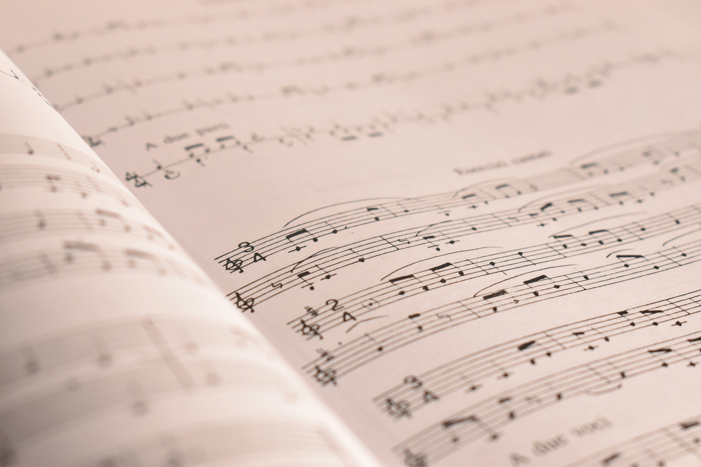
TUNE GENERATION PROCESS(OVERVIEW)
Model
Tune
Seed value = First Few notes

Slide 5
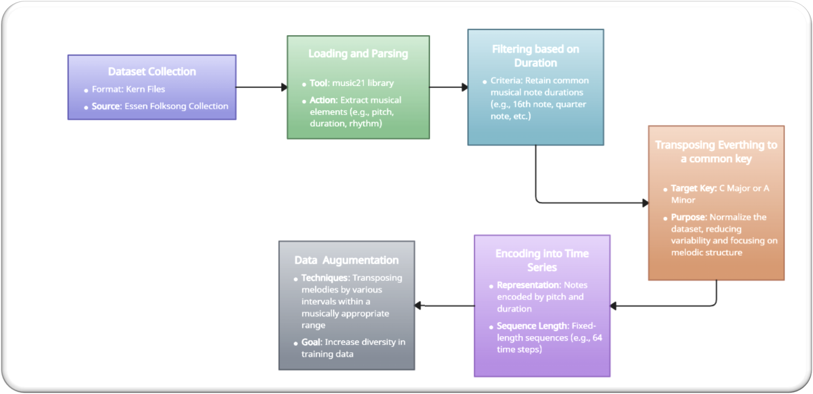
DATASET AND PREPROCESING
Notes:
Get Kern files only
Remove acceptable duration
Make it converted to same Key – C Major and A minor
Create dictionary
Based on the dictionary we create integer mapping
One hot encode
Sliding window approach
Inputs and targets with inputs and classes

Slide 6
MODEL ARCHITECTURES
LSTM
Vanilla RNNN
GRU
6

Slide 7
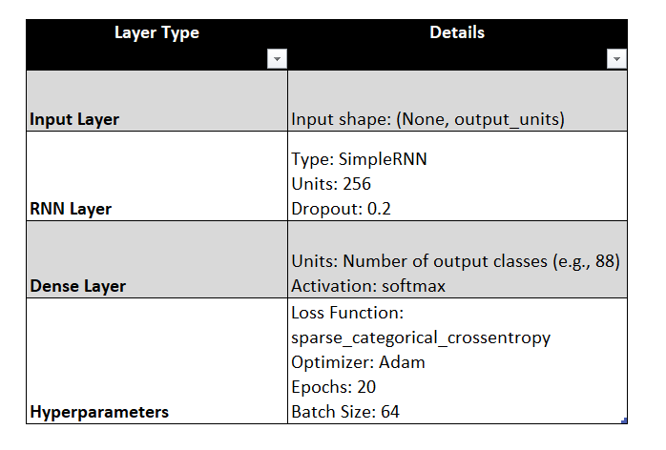
Vanilla RNN
Notes:
Input Layer:This means the model expects a sequence of data where the length of the sequence is variable (None), and each element in the sequence has a dimension of output_units.
RNN Layer:
Type: This layer is a SimpleRNN, which is a type of Recurrent Neural Network (RNN) that processes sequences of data.
Units: The RNN layer has 256 units, which determines the dimensionality of the output space of the RNN.
Dropout: A dropout rate of 0.2 is applied to this layer, which means that 20% of the units are randomly dropped out during training to prevent overfitting.
Dense Layer:
Units: The dense (fully connected) layer has a number of units corresponding to the number of output classes.
Activation: The activation function used is softmax, which is commonly used in the output layer for multi-class classification problems. It converts the outputs into probabilities.
Hyperparameters:
Loss Function: The model uses sparse_categorical_crossentropy as the loss function, which is appropriate for multi-class classification when the target labels are integers.
Optimizer: The model is optimized using the Adam optimizer, which is an adaptive learning rate optimization algorithm.
Epochs: The model is trained for 20 epochs, meaning the entire dataset will be passed through the network 20 times.
Batch Size: The batch size is set to 64, meaning the model processes 64 samples of data at a time before updating the weights.

Slide 8
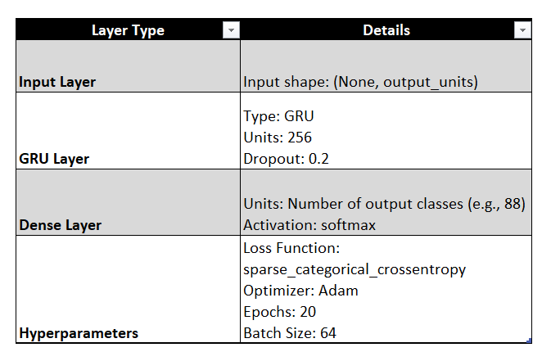
GRU RNN

Slide 9
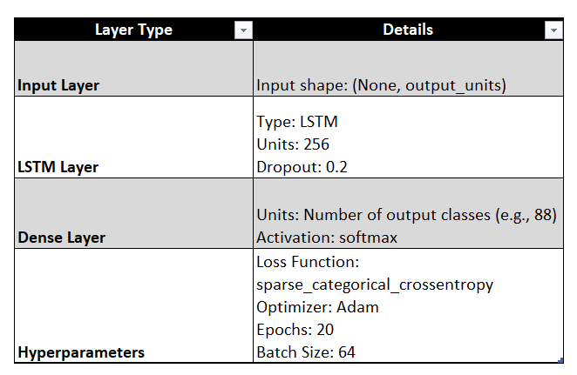
LSTM RNN

Slide 10
Results - Vanilla RNN
Training Accuracy:
Steadily improves from around 0.77 to approximately 0.83 by the 18th epoch.
Indicates effective learning from the training data.
Validation Accuracy:
Follows a similar upward trend, stabilizing around 0.82.
Suggests the model generalizes well to unseen data with minimal gap between training and validation accuracy.
Training Loss:
Consistently decreases from a high of 0.90 to around 0.50.
Reflects increasing model confidence in predictions.
Validation Loss:
Shows a downward trend, stabilizing around 0.55.
Indicates the model is converging and fine-tuning its weights.
Notes:
Training Accuracy:
The training accuracy steadily improves over the epochs, starting from around 0.77 and reaching approximately 0.83 by the 18th epoch. This indicates that the model is effectively learning from the training data.
Validation Accuracy:
The validation accuracy follows a similar upward trend, starting slightly above the training accuracy and stabilizing around 0.82. This suggests that the model generalizes well to unseen data, though the gap between training and validation accuracy remains small.
Training Loss:
The training loss decreases consistently throughout the training process, indicating that the model is becoming more confident in its predictions. It starts from a high value close to 0.90 and drops to around 0.50.
Validation Loss:
The validation loss also shows a downward trend, similar to the training loss, but with a slightly higher final value, stabilizing around 0.55. This is typical as the model converges and fine-tunes its weights.
Conclusion:
Overall Model Performance:
The Vanilla RNN model shows good learning capability with a stable convergence pattern. The slight difference between training and validation metrics indicates minimal overfitting, making this model a decent baseline for the task.

Slide 11
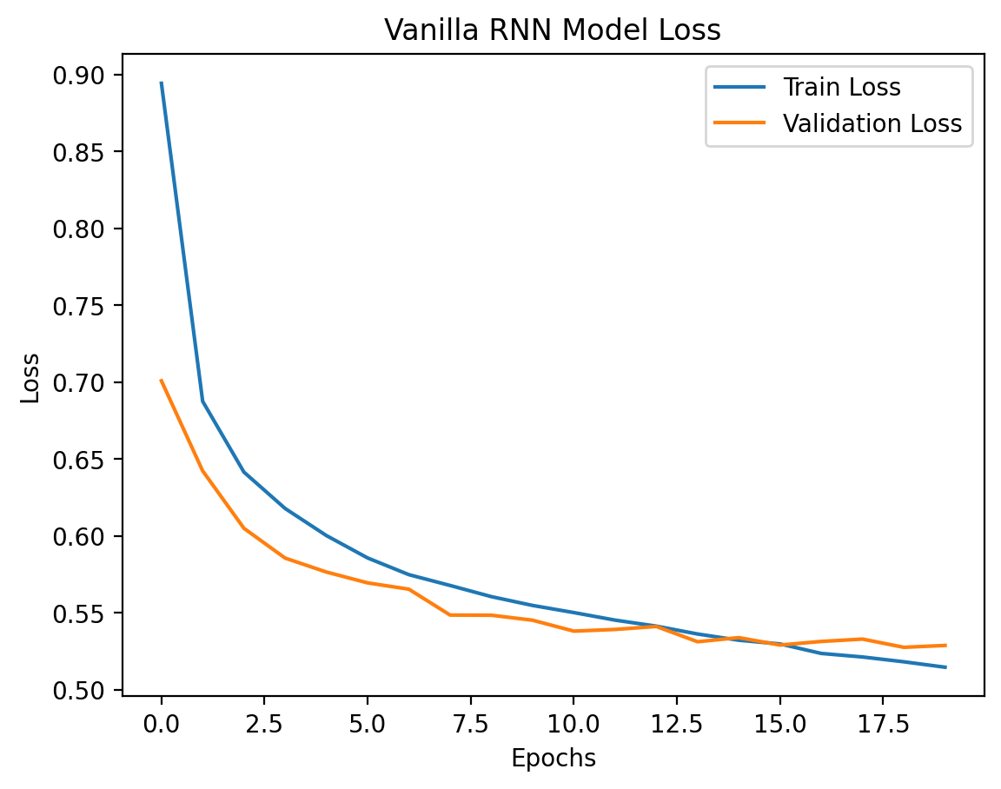
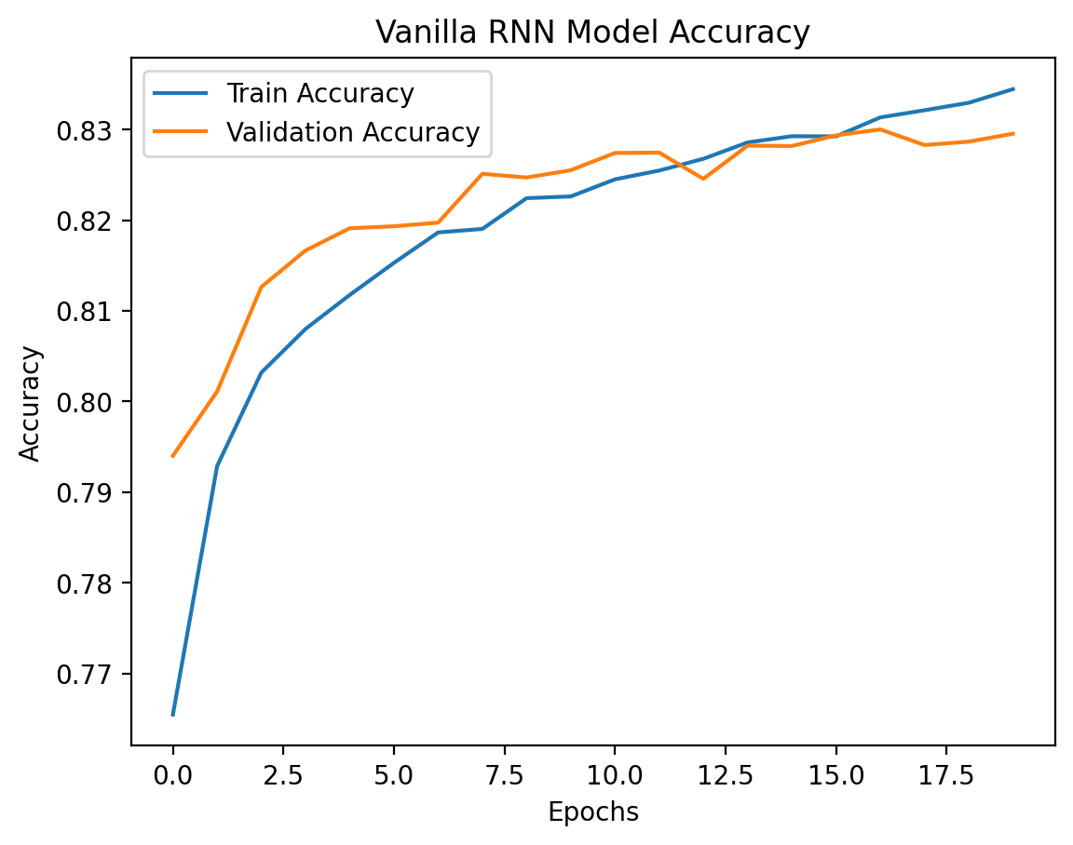
11

Slide 12
Results - GRU
Training Accuracy:
Starts at approximately 0.80 and improves steadily, reaching around 0.88 by the 18th epoch.
Demonstrates that the GRU model is effectively learning and refining its predictions over time.
Validation Accuracy:
Follows a closely related trend to the training accuracy, stabilizing around 0.84 to 0.85.
Indicates that the model generalizes well to unseen data, with minimal overfitting.
Training Loss:
Shows a consistent decrease from approximately 0.70 to about 0.35 by the 18th epoch.
Suggests that the model is improving its predictions and reducing errors over the training process.
Validation Loss:
Similarly decreases from around 0.55 to about 0.45, with a slight increase towards the end.
Reflects good convergence, although the slight rise towards the end might suggest the beginning of overfitting.
Notes:
Slide Title: Results - Vanilla RNN
Performance Overview:
Training Accuracy:
The training accuracy steadily improves over the epochs, starting from around 0.77 and reaching approximately 0.83 by the 18th epoch. This indicates that the model is effectively learning from the training data.
Validation Accuracy:
The validation accuracy follows a similar upward trend, starting slightly above the training accuracy and stabilizing around 0.82. This suggests that the model generalizes well to unseen data, though the gap between training and validation accuracy remains small.
Training Loss:
The training loss decreases consistently throughout the training process, indicating that the model is becoming more confident in its predictions. It starts from a high value close to 0.90 and drops to around 0.50.
Validation Loss:
The validation loss also shows a downward trend, similar to the training loss, but with a slightly higher final value, stabilizing around 0.55. This is typical as the model converges and fine-tunes its weights.
Conclusion:
Overall Model Performance:
The Vanilla RNN model shows good learning capability with a stable convergence pattern. The slight difference between training and validation metrics indicates minimal overfitting, making this model a decent baseline for the task.
Visuals:
Graphs:
Accuracy Curve: The graph illustrates the increasing trend in both training and validation accuracy, indicating effective learning.
Loss Curve: The graph depicts the reduction in both training and validation loss, supporting the conclusion of a well-trained model.

Slide 13
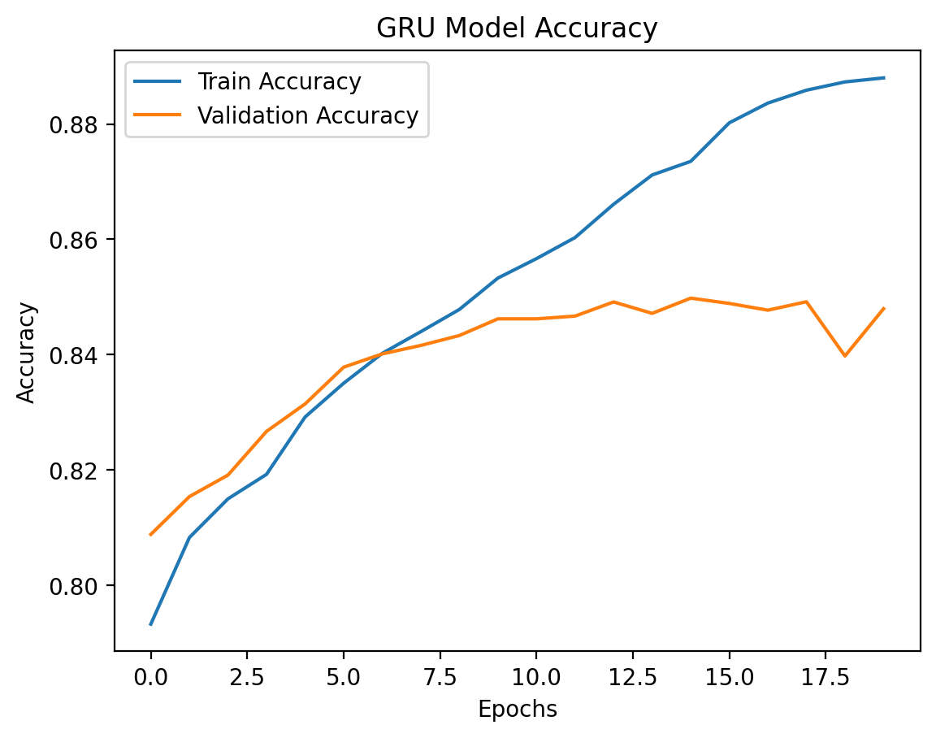
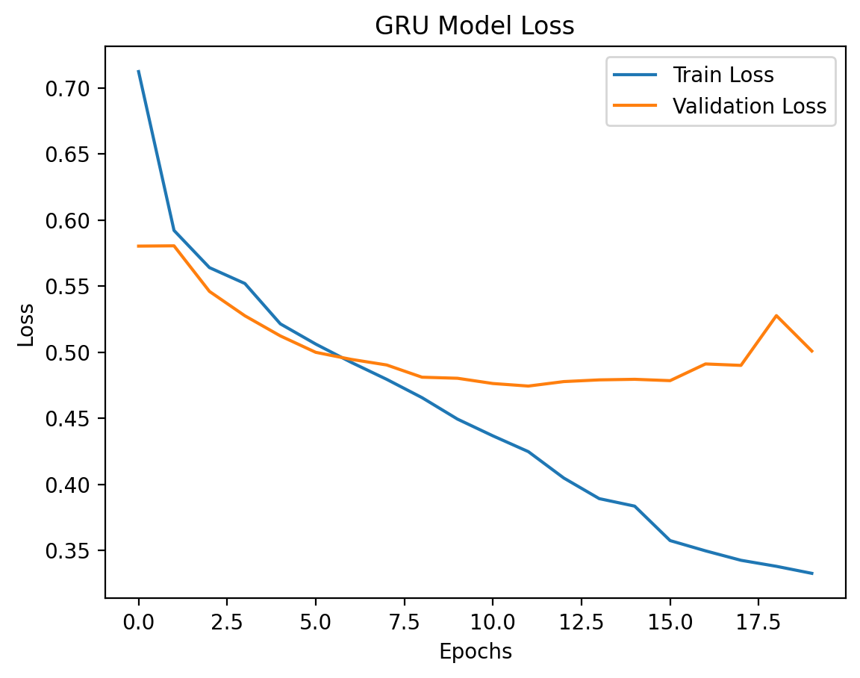
13

Slide 14
Results - LSTM
Training Accuracy:
Steadily improves from around 0.77 to approximately 0.83 by the 18th epoch.
Indicates effective learning from the training data.
Validation Accuracy:
Follows a similar upward trend, stabilizing around 0.82.
Suggests the model generalizes well to unseen data with minimal gap between training and validation accuracy.
Training Loss:
Consistently decreases from a high of 0.90 to around 0.50.
Reflects increasing model confidence in predictions.
Validation Loss:
Shows a downward trend, stabilizing around 0.55.
Indicates the model is converging and fine-tuning its weights.
Notes:
Slide Title: Results - Vanilla RNN
Performance Overview:
Training Accuracy:
The training accuracy steadily improves over the epochs, starting from around 0.77 and reaching approximately 0.83 by the 18th epoch. This indicates that the model is effectively learning from the training data.
Validation Accuracy:
The validation accuracy follows a similar upward trend, starting slightly above the training accuracy and stabilizing around 0.82. This suggests that the model generalizes well to unseen data, though the gap between training and validation accuracy remains small.
Training Loss:
The training loss decreases consistently throughout the training process, indicating that the model is becoming more confident in its predictions. It starts from a high value close to 0.90 and drops to around 0.50.
Validation Loss:
The validation loss also shows a downward trend, similar to the training loss, but with a slightly higher final value, stabilizing around 0.55. This is typical as the model converges and fine-tunes its weights.
Conclusion:
Overall Model Performance:
The Vanilla RNN model shows good learning capability with a stable convergence pattern. The slight difference between training and validation metrics indicates minimal overfitting, making this model a decent baseline for the task.
Visuals:
Graphs:
Accuracy Curve: The graph illustrates the increasing trend in both training and validation accuracy, indicating effective learning.
Loss Curve: The graph depicts the reduction in both training and validation loss, supporting the conclusion of a well-trained model.

Slide 15
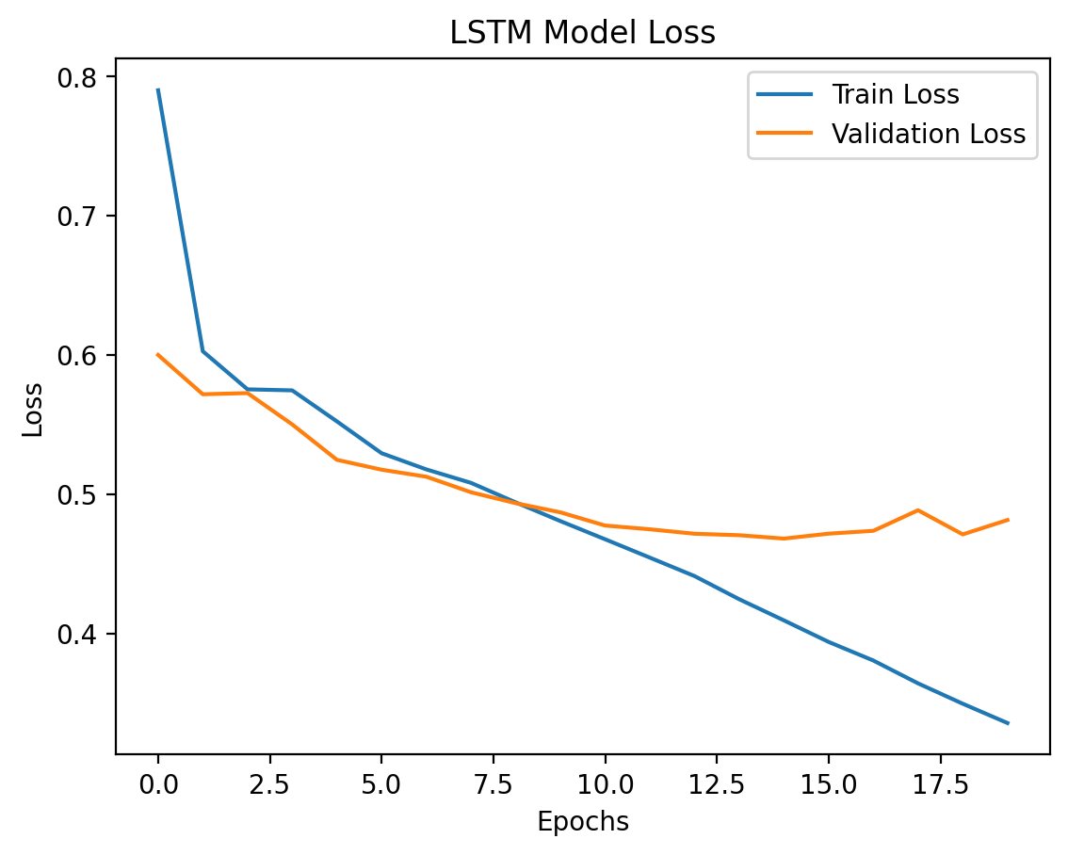
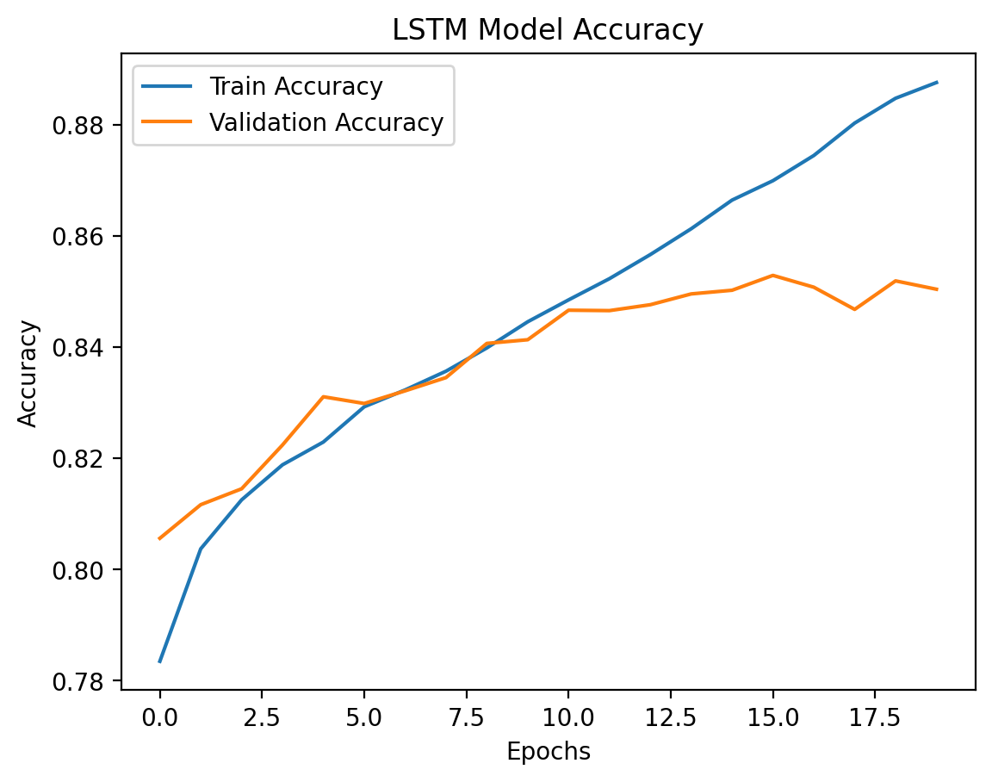
15
Notes:
GRU: Appears to have the best balance between training and validation performance, suggesting it generalizes better to unseen data.
LSTM: Strong training performance but slightly less stable on validation data compared to GRU.
Vanilla RNN: Shows weaker overall performance in both training and validation. Point out that in the first diagram, the training loss consistently decreases, indicating effective learning. However, the validation loss plateaus and shows some variability, which suggests potential overfitting.
In the GRU, both training and validation accuracies improve in parallel, with the validation accuracy curve being smoother and more consistent,

Slide 16
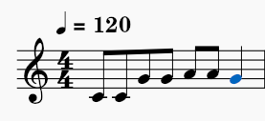
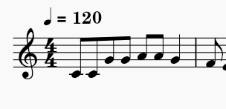
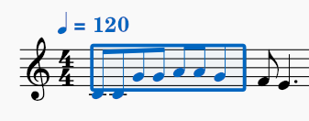
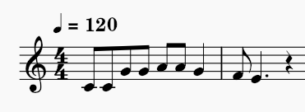
MELODY GENERATION PROCESS

Slide 17
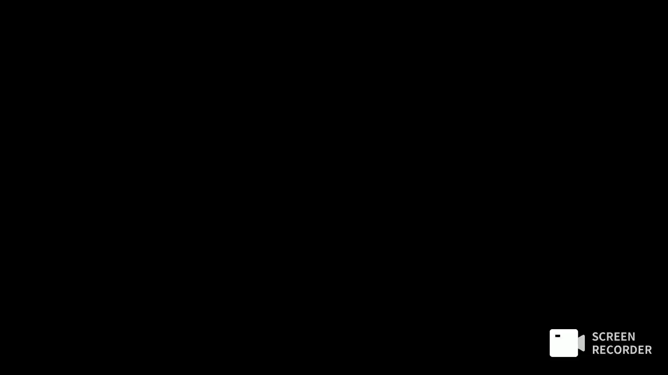
Visual Demo

Slide 18
Thank You Any Questions ?

